Slide 1
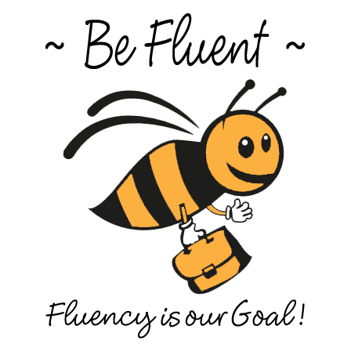
Speak Fluently & Confidently B2- Course 1

Slide 2
Session 5- A Diet Dilemma
Part 1-: A Diet Dilemma
( Listening)
Part 2: What would you say in the following
situations? ( More Idioms & collocations)
Part 3: Speaking Practice
https://befluent.me/

Slide 3
Session 5- A Diet Dilemma
Part 1-: A Diet Dilemma
( Listening)
https://befluent.me/

Slide 4
Lesson 05: A Diet Dilemma
Nathan gives his friend Matt advice on losing weight. First, listen to their conversation and answer these comprehension questions. Then learn the expressions in the dialogue.
Listening Comprehension
Matt needs to lose weight in order to...
become healthier
impress a girl
participate in a sports competition
How much weight does he need to lose?
four pounds
five pounds
ten pounds
He's eating too much because...
a member of his family is cooking a lot
he's stressed about school
he can’t cook, so he just eats fast food
One person causing problems for Matt is his...
aunt
coach
girlfriend
Nathan suggests...
becoming a vegetarian
eating healthier meals
taking cooking classes
Where do they go at the end of the conversation?
the gym
the library
the supermarket

Slide 5



Conversation Text
Vocabulary
Matt: Oh man, I can’t believe this. What a drag.
What a drag = This is annoying
Nathan: What’s with you?
Matt: Coach Davis just put me on a diet. He said I’m four pounds over my weight class. If I don’t shed four pounds I won’t be able to wrestle in the State Tournament.
What’s with you? = What’s the problem you’re having?
shed four pounds = lose four pounds
Nathan: So what’s the big deal? Lay off the potato chips, jog a few miles, and drop the pounds. It’s not like you have to lose fifty pounds or anything. Four pounds shouldn’t be too hard.
What’s the big deal?
= This isn’t such a big problem
lay off the potato chips = eat less of (or stop eating) the chips
Matt: You don’t get it. My Aunt Mae is in town. And man oh man… she’s been cooking up a storm and if you refuse to eat, she cries.
You don’t get it = You don’t understand
cooking up a storm = cooking a LOT
Nathan: Yeah, I remember your Aunt Mae. Didn’t she just get divorced or something?
fill the void = feel better after a loss
Matt: Yeah, and now she’s using food to fill the void. Unfortunately, she’s making everyone else eat with her. Last night Aunt Mae made me eat three pieces of
pecan pie. If I continue at this rate I’ll be as fat as a
blimp in no time.
blimp = a type of large, round air vehicle
Nathan: I guess you do have a problem. Of course you don’t want to hurt your aunt’s feelings. But you can’t

Slide 6



let her stop you from making the wrestling tournament. You’re the best wrestler in your weight class.
Vocabulary
making the wrestling
tournament = being able to participate in the tournament
Matt: I sure am. But if I don’t get out of Aunt Mae’s food binge, I’ll be wrestling in the sumo weight class pretty soon.
binge = eating too much, an excessive amount
Nathan: Seems to me like you’re going to have to tell your Aunt Mae to back off, somehow. Just explain the situation to her. I’m sure she’ll understand.
back off = stop being so aggressive
Matt: I’m not so sure. She’s really into this cooking thing. And I hate to say it, but’s she’s already pretty plump around the waist, too.
She’s really into = she’s very interested in / dedicated to
Nathan: Hey, I got an idea.
plump = fat
Matt: Lemme hear it, dude. I’ll take anything at this point.
Lemme = let me
cope with = manage emotionally
Nathan: Your Aunt Mae is into cooking to help her
cope with her divorce. So if you can’t beat her, join her.
Shut up = Stop talking. This is a
rather rude way to say this, and it should only be used between two close friends who have a good relationship and can joke with each other.
Matt: But I’m trying to lose weight, not gain it.
Nathan: Shut up and listen. Just ask your Aunt Mae to start cooking healthy, fat free meals, stuff with low carbs and high in protein.
Matt: Well, that might work. But my Aunt Mae is really into pasta… and the sweets that follow. I don’t even
carbs = carbohydrates
wanna know how many calories those slices of pecan pie had.

Slide 7



Nathan: But you can surely suggest different meals.
Matt: Well, I guess it wouldn’t hurt.
Vocabulary
Nathan: Look, Matt, the team needs you. So either you open your mouth at dinner time and suggest healthy meals… or else say goodbye to making the State Tournament.
it wouldn’t hurt = it
wouldn’t have any negative effect; it could be good to try
Matt: I know, I know… maybe I can check out a healthy cookbook at the library and take it home with me?
say goodbye to = accept the fact that
this opportunity will not happen
Nathan: Now you’re talking. I’m sure you’ll find a way to drop four pounds without hurting your Aunt’s feelings. Don’t stress about it. Come on, I’ll walk over to the library with you.
check out = in this context, it means
borrow a book from the library
Now you’re talking. =
Now you’re saying the
right thing; now you’re having a good idea

Slide 8
Vocabulary Quiz
Complete each sentence with a word from the box. Two words are not used.
back off | fill the void | not really into | what a drag
cope with | it couldn’t hurt | now you’re talking | what's the big deal
doesn’t get it | made | say goodbye to | what's with you
A friend of mine it to the final round of a popular game show - but she was eliminated before winning any prizes.
He couldn't the disappointment of not getting the promotion, so he ended up quitting.
If the government cuts funding for the arts, we'll have to _ the possibility of a community theater.
Man, you've asked her out multiple times and she hasn't said yes - you should probably .
It's just a little get-together among friends, so if we're a few
minutes late?
I've tried to explain the computer program to him, but he's not very tech- savvy, so he just .
That's the fifth mistake you've made today. ? Have you got
something on your mind?
We enjoyed the Star Trek movie even though we're science fiction.
You have to work overtime again? . That's the third time this
week.
If you're going abroad for six months, to get your international driver's license - you never know when you might need to drive.

Slide 9
Speaking Task
This conversation describes a delicate situation; Matt needs to achieve his goal without offending his aunt by rejecting her homemade food.
Describe a time when you had to resolve something and there was the danger of hurting someone’s feelings. How did you handle it?
Do you tend to be “blunt” (speaking very directly and honestly, regardless of how it might affect the other person) or are you very careful not to make anyone upset?
Answers
Comprehension Questions: c a a a b b | Vocabulary Quiz: made cope with say goodbye to back off what's the big deal doesn't get it what's with you not really into what a drag it couldn't hurt

Slide 10
Session 5- A Diet Dilemma
Part 2: What would you say in the following
situations? ( More Idioms & collocations)
https://befluent.me/

Slide 11
Session 5- A Diet Dilemma
Couch potato
Meaning: Someone who does not exercise and sits on the sofa watching a lot of TV
Example : Mum wants us all to join her yoga class and stop being couch potatoes.
Don’t bite off more than you can chew
Meaning: Don’t try to do more than you are able. If you take too big a bite of food, you will have trouble trying to swallow it, and could choke.
Example: Anna thinks I’ve bitten off more than I can chew by joining the choir, the orchestra and the debating team, but I think I’ll be fine.
A piece of cake
Meaning: something that is easy to do Example : “Scoring all A’s was a piece of cake. I didn’t even study properly!” boasted Philip.
Bring home the bacon
Meaning: to earn money to live on Example : Mary was tired of being the only one in the family bringing home the bacon.
Cheap as chips
Meaning: really inexpensive Example : “This chair is on sale; it’s practically cheap as chips!”
https://befluent.me/

Slide 12
Session 5- A Diet Dilemma
Not your cup of tea
Meaning: it is not the type of thing that you like Use it: “Drag racing really is not my cup of tea,” said Hank.
Take something with a pinch of salt
Meaning: to not completely believe something that you are told, because you think it is unlikely to be true Use it: “Neil lies all the time, so people often take what he says with a pinch of salt.”
Have your cake and eat it too
Meaning: to have all the benefits of a situation when, in fact, having one thing means that you cannot have the other Use it: Simon wants to go to university, but does not want to study. His parents say he cannot have his cake and eat it too.
As cool as a cucumber
Meaning: very calm and relaxed, especially in a difficult situation Use it: He was as cool as a cucumber, considering he was talking about his company going bankrupt.
https://befluent.me/

Slide 13
Session 5- A Diet Dilemma
Egg on someone
Meaning: to encourage someone to do something, especially something unwise or bad Example : Egged on by his friends, he was determined to fight his rival.
In a nutshell
Meaning: using as few words as possible Example : The situation in Syria is too complex to be explained in a nutshell.
Eat humble pie
Meaning: to admit that you were wrong Example: The politician was forced to eat humble pie after losing his seat in the general election.
Be like taking candy from a baby
Meaning: to be very easy Example: The game of tennis seems so easy for him, it’s like he’s taking candy from a baby.
https://befluent.me/

Slide 14
Session 5- A Diet Dilemma
Part 3: Speaking Practice
https://befluent.me/

Slide 15
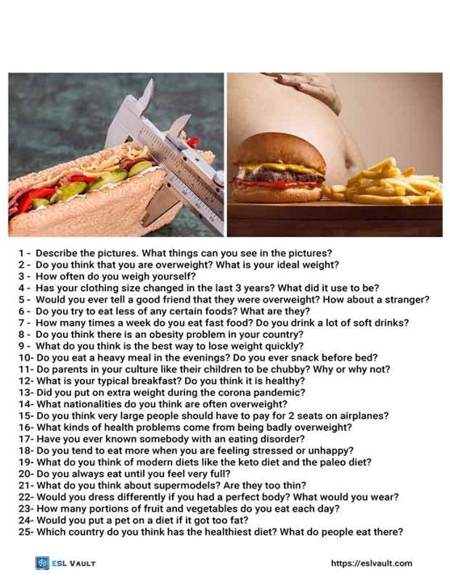
Session 5- A Diet Dilemma
https://befluent.me/

Slide 16
Session 5- A Diet Dilemma
(2) Tell me about your regular diet.
(3) Have you ever been on a diet?
(4) Do you think people who go on diets get the proper nutrition their body needs?
(5) Do you think the fashion and advertising industries are responsible for encouraging women to be super skinny?
(7) Are you happy with your weight and body shape?
(8) How important is exercising as part of a diet?
(9) Do people in your country eat a well-balanced diet?
How often do you weigh yourself?
Do you worry about your weight?
(2) How much weight would you like to lose or put on?
(3) Are dietary habits in your country changing?
(4) Do you know anyone who is obsessed with their weight and their figure?
(5) What’s your advice for anyone who wants to diet?
(6) Are there any dangers of dieting?
(7) Why are people so worried about the way their body looks?
(8) What do you think of all the fad diets that come on the market?
(9) Do you think it’s possible to lose weight and enjoy eating?
(10) Do you have a balanced diet?
https://befluent.me/

Slide 17
Session 5- A Diet Dilemma
Has your clothing size changed in the last 3 years? What did it use to be?
Would you ever tell a good friend that they were overweight? How about a stranger?
Do you try to eat less of any certain foods? What are they?
How many times a week do you eat fast food? Do you drink a lot of soft drinks?
Do you think there is an obesity problem in your country?
What do you think is the best way to lose weight quickly?
Do you eat a heavy meal in the evenings? Do you ever snack before bed?
Do parents in your culture like their children to be chubby? Why or why not?
What is your typical breakfast? Do you think it is healthy?
Did you put on extra weight during the corona pandemic?
What nationalities do you think are often overweight?
Do you think very large people should have to pay for 2 seats on airplanes?
What kinds of health problems come from being badly overweight?
Have you ever known somebody with an eating disorder?
Do you tend to eat more when you are feeling stressed or unhappy?
What do you think of modern diets like the keto diet and the paleo diet?
Do you always eat until you feel very full?
What do you think about supermodels? Are they too thin?
Would you dress differently if you had a perfect body? What would you wear?
How many portions of fruit and vegetables do you eat each day?
Would you put a pet on a diet if it got too fat?
Which country do you think has the healthiest diet? What do people eat there?
https://befluent.me/

Slide 18
Session 5- A Diet Dilemma
Thank you!☺
https://befluent.me/

